Slide 1
Writing for master students: objectives and challenges
Bauman University, December 2016
Svetlana Suchkova
suchkova_@yahoo.com

Slide 2

syllabus
?

Slide 3

What are the objectives?
Handout I
Work in pairs. Discuss the Master student profile.

Slide 4
What challenges do
your students face?

Slide 5


Slide 6
Survey: Do you teach how to
pre-write
edit and proofread drafts
paragraph a text
write a thesis statement
develop and connect ideas
use formal language
acknowledge authors
quote others
paraphrase
summarize
Notes:
Can I have a show of hands?

Slide 7
What are the problems?
Handout II
Identify the problems in writing.

Slide 8
Sample: Problems
I would like to compare two periodicals in the field of engineering. My major is a Spacecraft engineering. For that particular reason, I will be comparing two Scopus journals on the basis of its title, article’s structure and references. The first journal is entitled: «Transactions on Aerospace and Electronic Systems», the second one is «Engineering Letters».
Deviation
from the topic
Staying
in one place
Wordiness
Punctuation

Slide 9

Sample 2
I would like to compare two Scopus journals in the field of engineering - Transactions on Aerospace and Electronic Systems and Engineering Letters – taking into account the article structure, article titles, and the style of references.

Slide 10
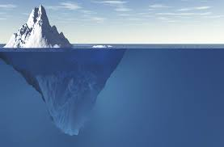
Learner’s Challenges
Language problems
Study & organizational skills
Cultural differences
Process writing skills, structuring a text
Grammar, vocabulary, punctuation, register
Conventions of ideas development, genre features, journal requirements
Notes:
pre-writing, editing skills
problems in structuring a text:
- paragraphing
- stating the main idea clearly
- developing it
problems in progression of ideas:
- jumping or staying in one place
- lack of cohesion

Slide 11
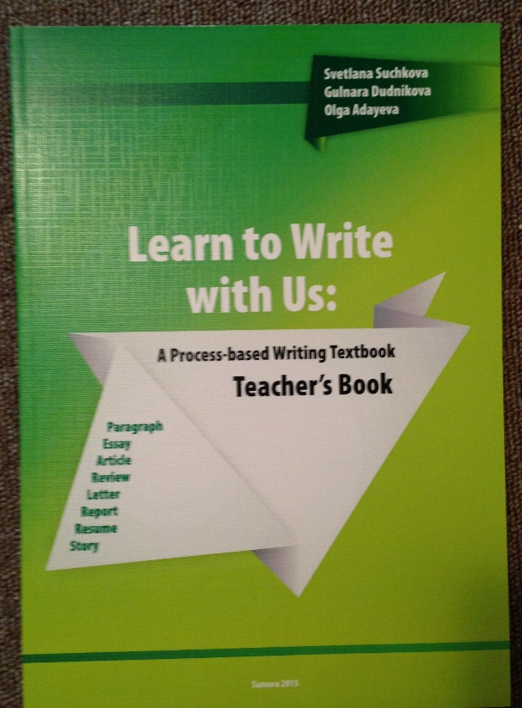
Principles
Diagnostic writing
Drafting & redrafting
Raising awareness
Focused activities
Teaching strategies
Peer teaching

Slide 12
Coherence and Unity
Handout III
Put the sentences in order.

Slide 13
Sample
A Twelve years after Sputnik, the United States caught up by becoming the first nation to land a man on the Moon.
B European Space agency was founded in 1975, and they joined the competition, vowing to land European astronauts on the Moon by 2025 and on the Mars by 2035.
C The number of nations competing in the “space race” has grown since the early days of space exploration.
D China joined the competition in 2003 when it launched Shenzhou5.
E Initially, the former Soviet Union took the lead when it sent the first Sputnik in 1957 and later a man into the Earth orbit.
F For almost 50 years, the United States and Russia were the only competitors in the contest to explore space using manned spacecraft.

Slide 14
Sample
F For almost 50 years, the United States and Russia were the only competitors in the contest to explore space using manned spacecraft.
E Initially, the former Soviet Union took the lead when it sent the first Sputnik in 1957 and later a man into the Earth orbit.
A Twelve years after Sputnik, the United States caught up by becoming the first nation to land a man on the Moon.
B European Space agency was founded in 1975, and they joined the competition, vowing to land European astronauts on the Moon by 2025 and on the Mars by 2035.
D China joined the competition in 2003 when it launched Shenzhou5.
C The number of nations competing in the “space race” has grown since the early days of space exploration.
F E A B D C

Slide 15
Sample
F For almost 50 years, the United States and Russia were the only competitors in the contest to explore space using manned spacecraft.
E Initially, the former Soviet Union took the lead when it sent the first Sputnik in 1957 and later a man into the Earth orbit.
A Twelve years after Sputnik, the United States caught up by becoming the first nation to land a man on the Moon.
B European Space agency was founded in 1975, and they joined the competition, vowing to land European astronauts on the Moon by 2025 and on the Mars by 2035.
D China joined the competition in 2003 when it launched Shenzhou5.
C The number of nations competing in the “space race” has grown since the early days of space exploration.
Notes:
Transition words of sequence, lexis: nations / countries, space

Slide 16

1 para = 1 idea

Slide 17
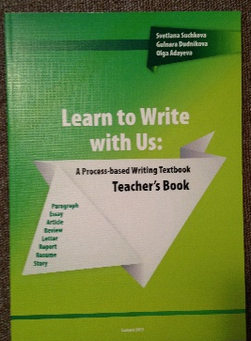
Unity (activities)
Read a paragraph and odd a phrase out
Read a paragraph and cross out a sentence that is not related to the meaning of the rest of the paragraph
Write a paragraph and insert an absurd phrase/sentence for your friend to find

Slide 18

One sentence glides into the next.

Slide 19
Coherence (activities)
Rewrite a paragraph in a more effective order
Organize the jumbled sentences
Write a jumbled paragraph and give it to your friend to rearrange the ideas
Make up a story from the stripes which are given in a jumbled order

Slide 20
Topic sentence
Handout IV
Write the topic sentence.
Analyze students’ sentences.

Slide 21
Case: Topic Sentence
Extreme holidays are the best in California.
Extreme rest in California forests is unusual.
There are special conditions for extreme trips in California.
California is noted for its nature.
There are nice weekends in California.
The best choice for spending holidays in California.
There are some reasons for visiting California if you are a nature lover.
You can see different places in California.
There are some reasons why you should visit California.

Slide 22

Topic sentence = topic + aspect to discuss + cue to organization

Slide 23
Topic Sentence / Conclusion
Identify the topic sentence / conclusion in a model paragraph
Choose an appropriate topic sentence from some suggested
Write the topic sentence for each set of details
Read the paragraph and write the topic sentence
Match the topic sentence and conclusion

Slide 24
Ideas Development
Handout V
Put the sentences in order.

Slide 25
Case: Ideas Development
Specifically, when I worked at a resort hotel I met people from several different countries with whom I have chatted on the Internet.
Without the Internet I could spent a week for that, but I founded it for two days.
There are a lot of other good programs information about those you can find only in the internet. For example, Khan Academy website which can help you to understand natural sciences.
Due to internet resources you can find desirable work quite quickly and without any difficulties.
The first reason why computer is useful is that there are a lot of opportunities of finding a job abroad.

Slide 26

PEEL

Slide 27
Cohesion
Handout VI
Put the sentences in order.

Slide 28

links

Slide 29
Cohesion (activities)
Find the linking words in a paragraph and identify what type of organization they follow
Use signal words to combine each set of sentences into one sentence
Fill in the gaps choosing the right linking words from those given in brackets
Make up a card for a partner with three sentences to illustrate each pattern of organization. Ask him/her to underline
all the signals and identify the pattern

Slide 30

Book Features
combination of process and product approaches to writing
skills integration and awareness raising
peer teaching
system of various tasks on every stage, variety of topics
focus on effective writing strategies
from paragraph to article, essay, review, story, report, CV, letters, etc.
punctuation guide and appendices
Лауреат Всероссийского конкурса на лучшую научную книгу 2010 года, проводимого Фондом развития отечественного образования
Лауреат I Международного конкурса учебно-методической, учебной и научной литературы, изданной в 2011 году «Золотой корифей» (II место)

Slide 31

Basic Course Foci
developing writing strategies: pre-writing, drafting, editing, proofreading
integrating writing with reading
paragraph level activities
training Ss in proper use of other people’s ideas, texts
developing students’ formal language
Notes:
gradual progress from simple forms to more complex ones – from a sentence to a paragraph to an essay
developing writing strategies: pre-writng, drafting, editing, proofreading
teaching different rhetorical models of content organization: definition, process description, cause-effect relationship, etc.
training students in proper use of other people’s ideas, texts
developing students’ formal language

Slide 32
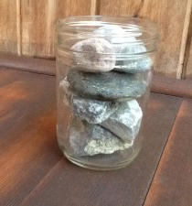
‘Do not forget to put the rocks in first!’

